Slide 1
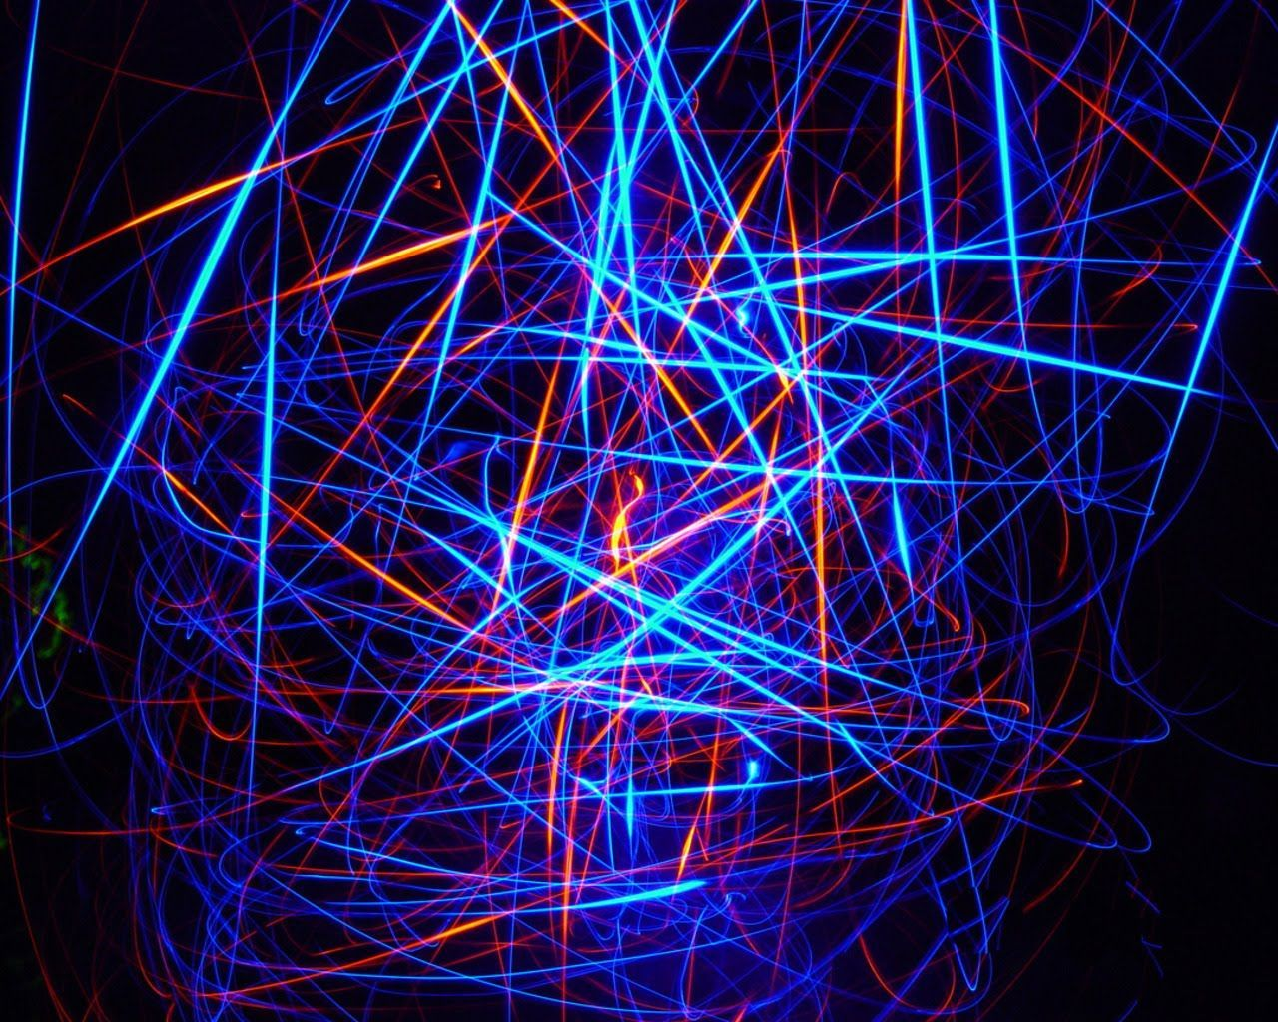
KST
29
CHESS
KST
29
NOVELS
CHESS
NOVELS
ML
EPE
ML
SD
ENG
EPE
SD
AI
BOOKS
DE
10
TM
DE
CONFIDENCE
ENG
TT
TT
RANDOM
PYTHON
2001
KST
BOOKS
TSAONGAF
TSAONGAF
10
PYTHON

Slide 2

KST
Python with Khaled Saje’
LEC 1
KST

Slide 3

What we will learn in this LEC:
By Khaled Tayem
Know what is programming language
Why python?
Python applications
Python installation
Interpreter and Compiler
KST

Slide 4

By Khaled Tayem
KST

Slide 5

By Khaled Tayem
Why python
Free and Open Source
Interactive language
Easy to install
Clean
Error handling
Debugging is easy
Cross platforms
KST

Slide 6

By Khaled Tayem
Python Applications:
KST

Slide 7

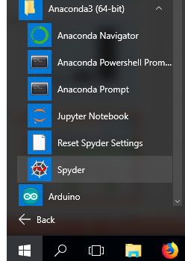
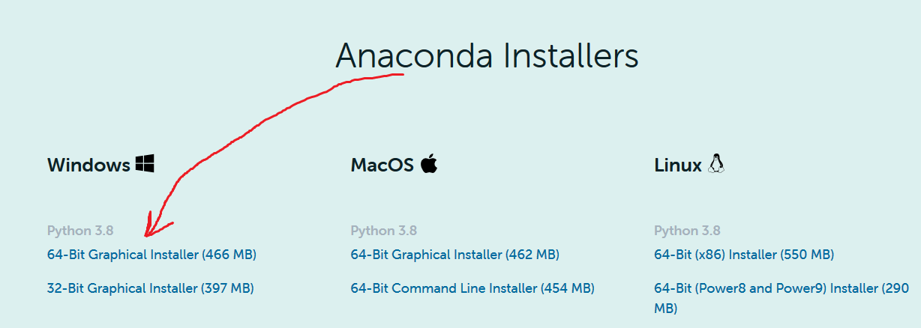
Python Installation:
By Khaled Tayem
KST
Notes:
Websites for coding:
https://www.onlinegdb.com/online_python_compiler
https://www.programiz.com/python-programming/online-compiler/

Slide 8

By Khaled Tayem
Compiler and interpreter
KST

